Slide 1
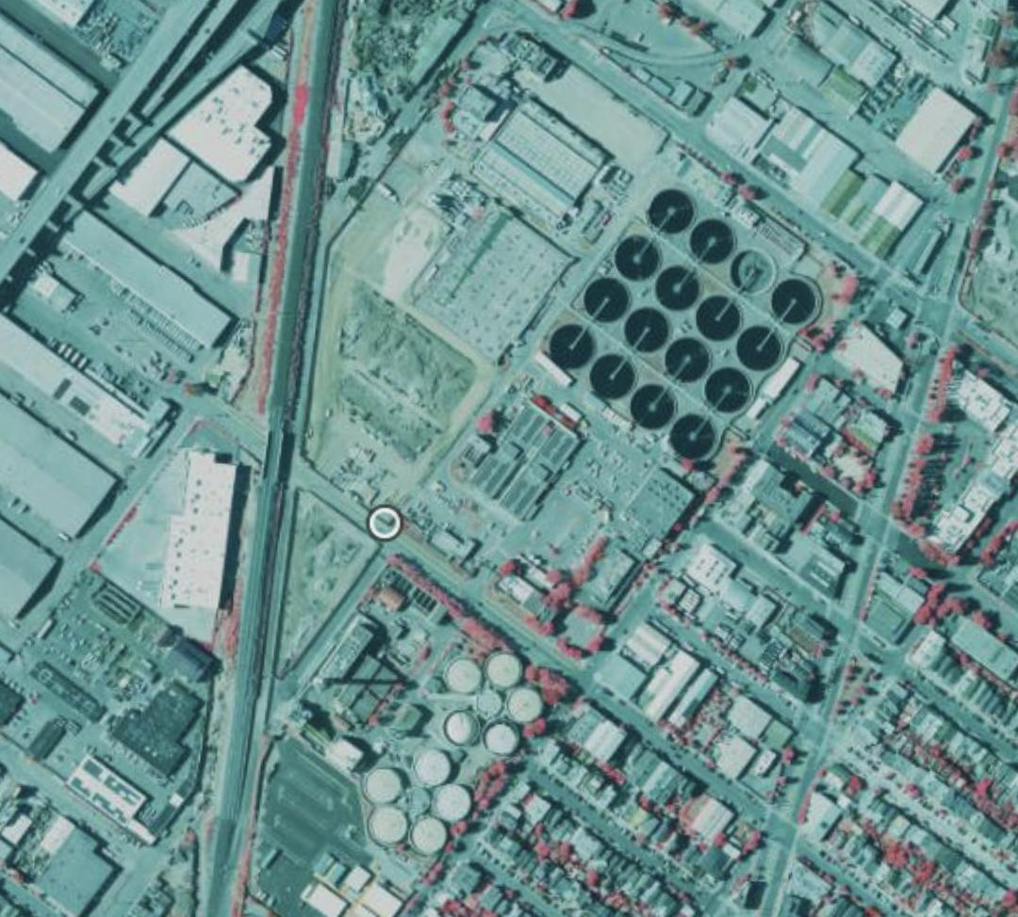
WWTP Project End-of-Semester Presentation
November 30, 2023

Slide 2
Outline
Summary of this semester-long project progress
Future Plan

Slide 3
Progress Summary
California + Texas Manual Tagging Done
List of potential WWTPs for all states created based on OSM
EPA data explored
List from Renan explored

Slide 4


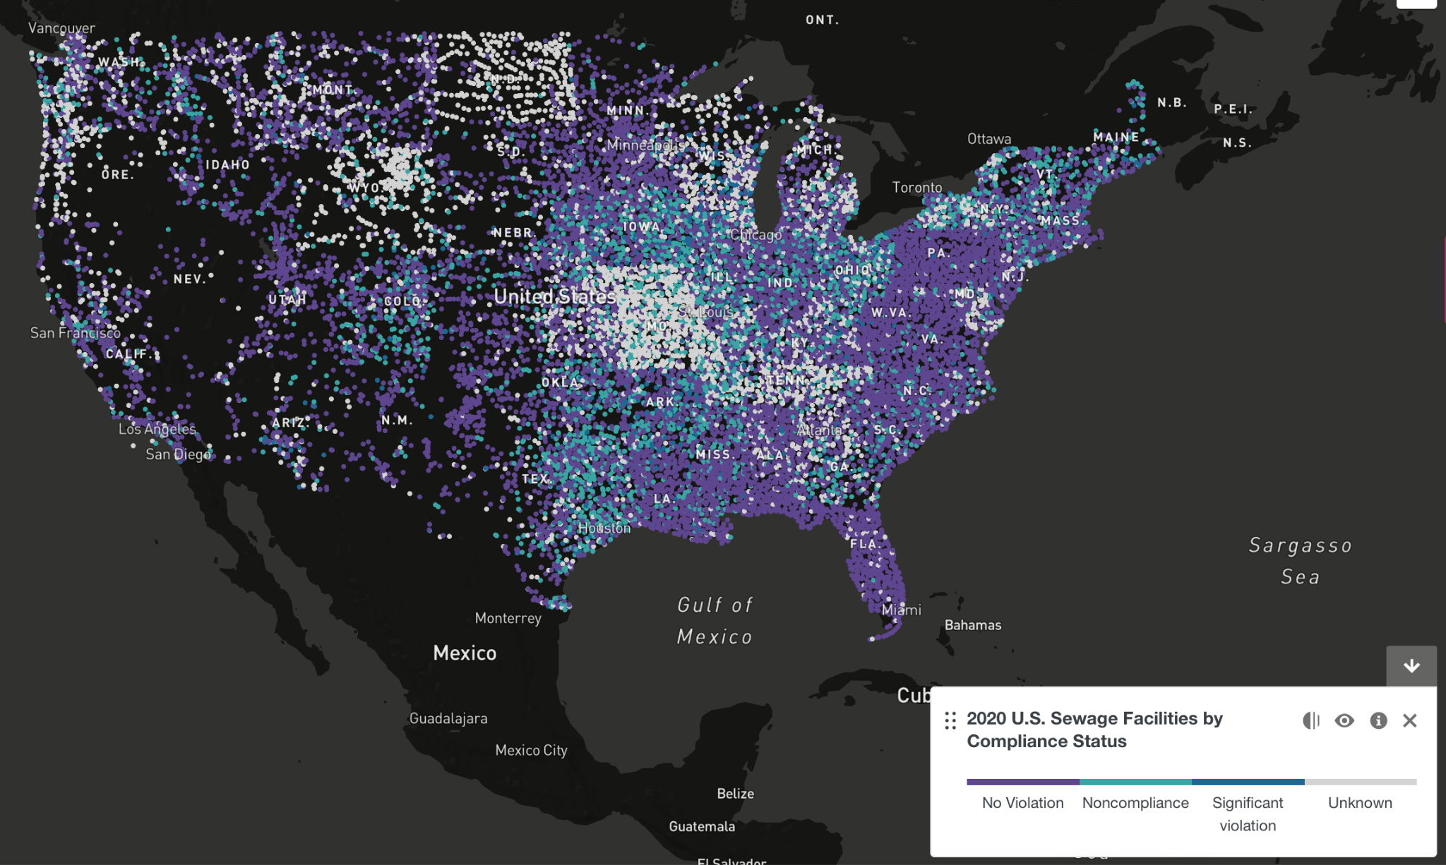

Data Sources
Approved List of 40 Solar Verified WWTP
OpenStreetMap
EPA
CA State Water Resources Control Board

Slide 5
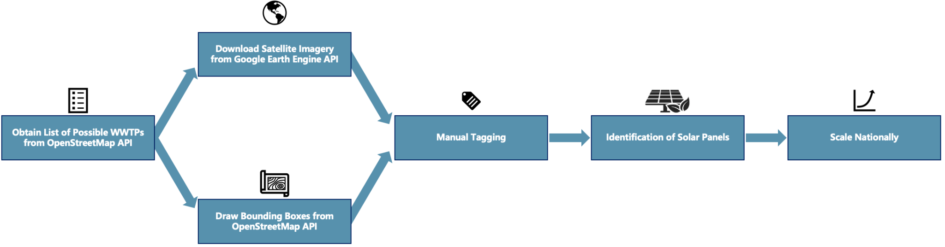
Current Methodology

Slide 6
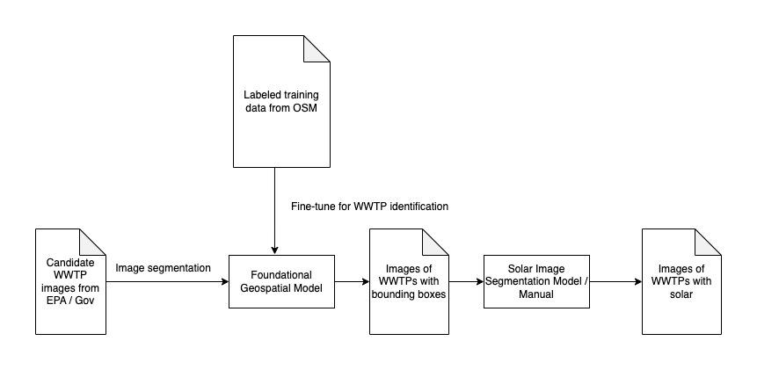
Future Methodology

Slide 7
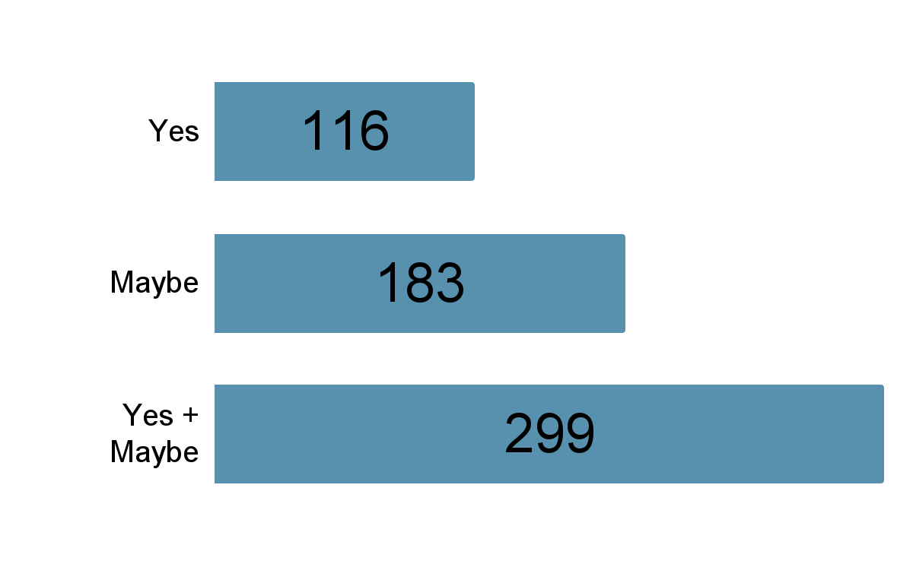
California WWTP Tagging Results
Out of 3104
Percentage Range:
3.737% ~ 9.632%
Excel Sheet:
Yes List
Yes + Maybe List

Slide 8
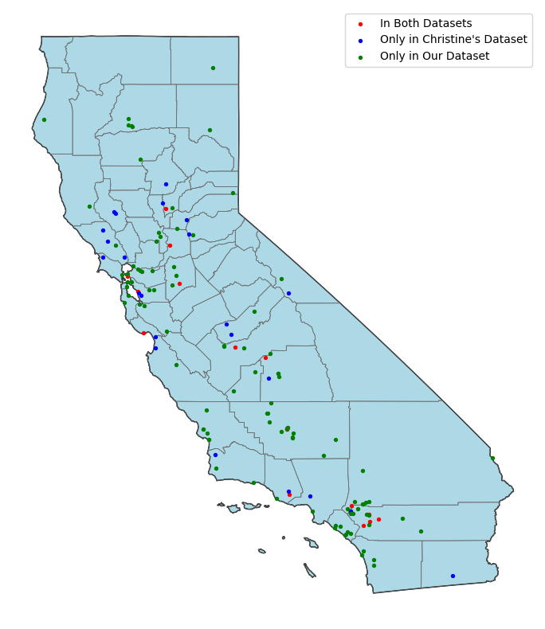
California WWTP Tagging
Distance defining the two WWTPs are the same: 1 km
17 WWTPs in common

Slide 9
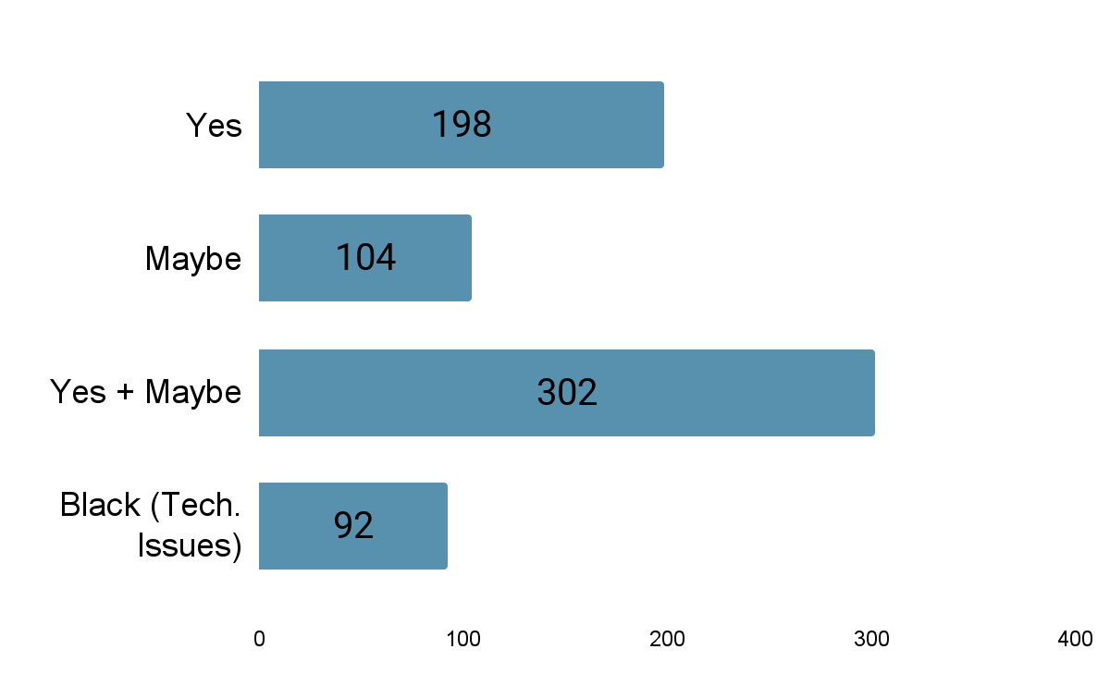
Texas WWTP Tagging Results
Out of 543
Percentage Range:
36.50% ~ 55.62%
Black Images: 92 (16.94%)
Related to the specified time period that we need to input for Google Earth API
Higher Ratio than CA
Excel Sheet:
Yes List
Yes + Maybe List

Slide 10
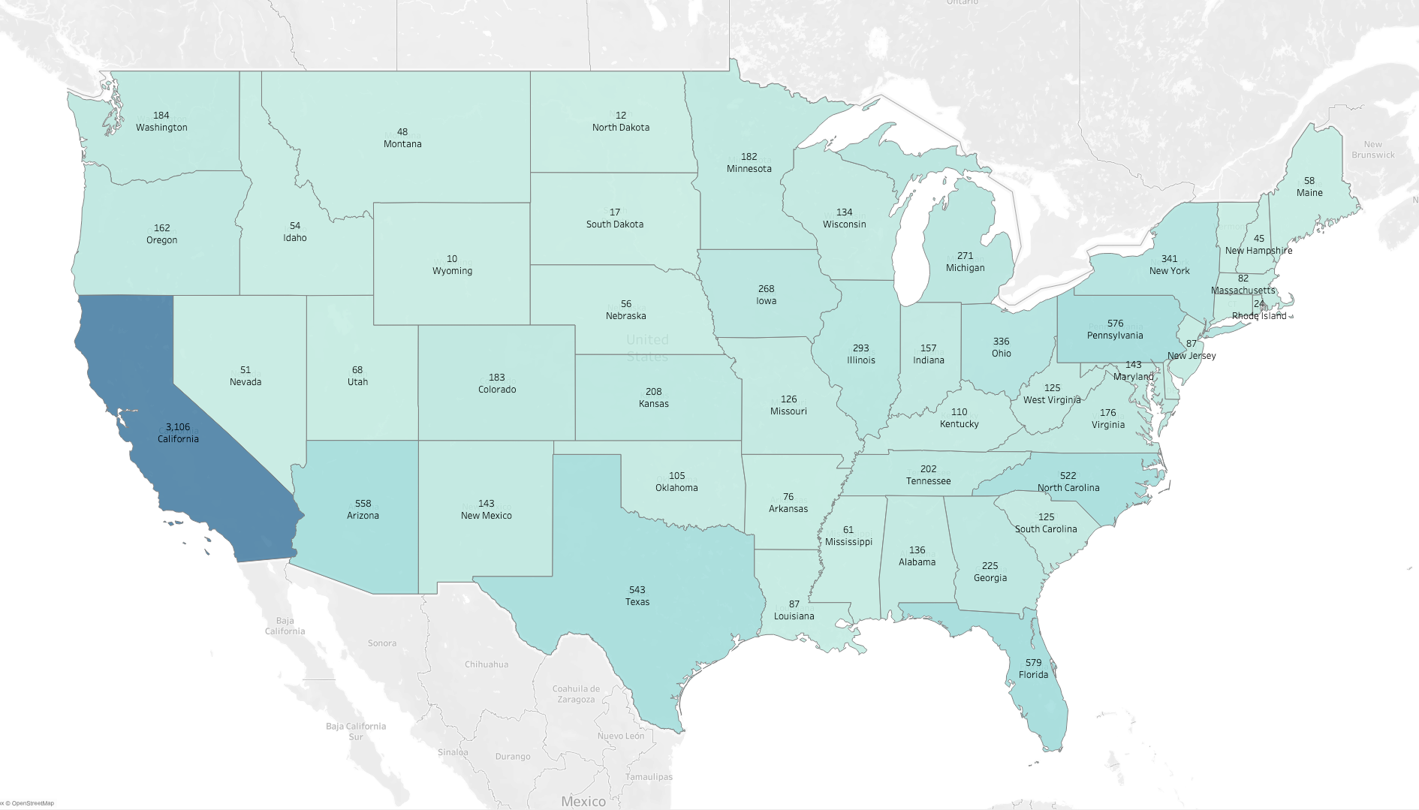
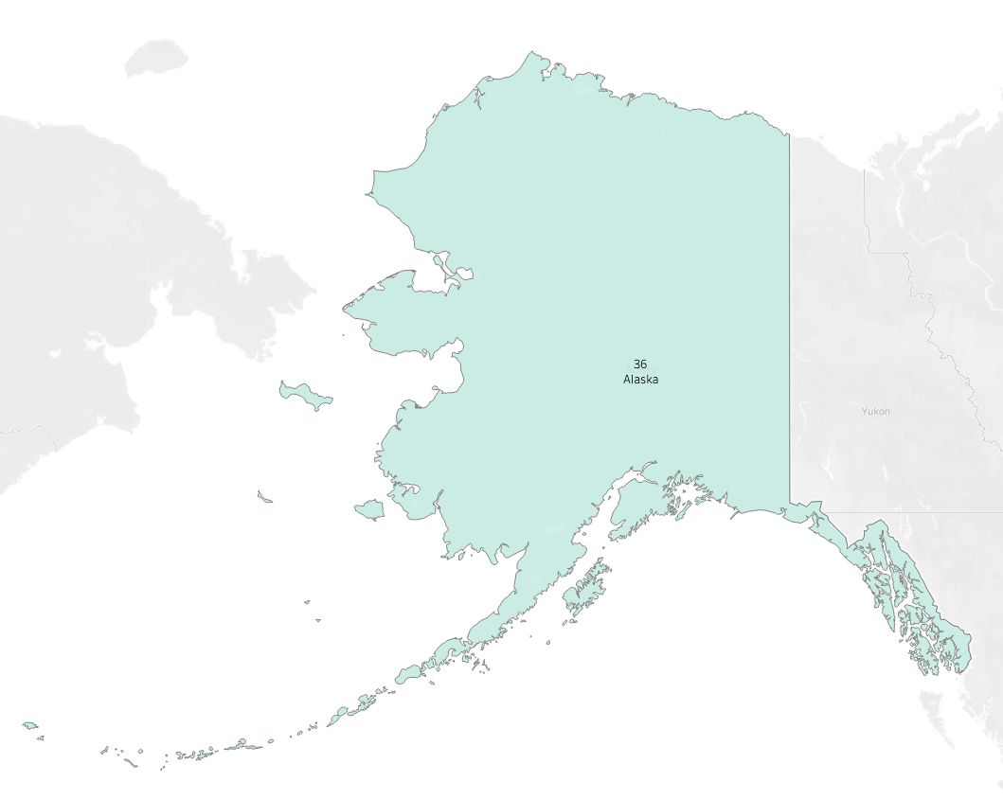
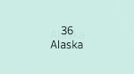
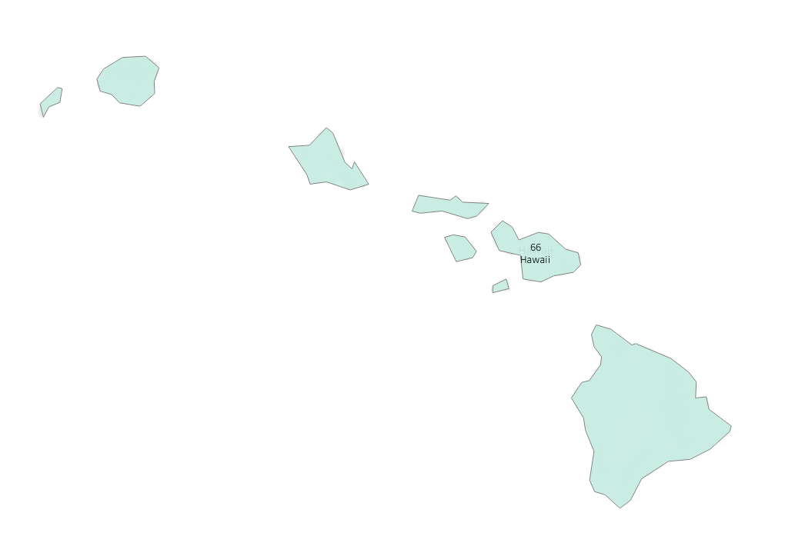
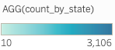
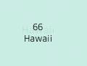
Num. of Potential WWTPs across states from OSM

Slide 11
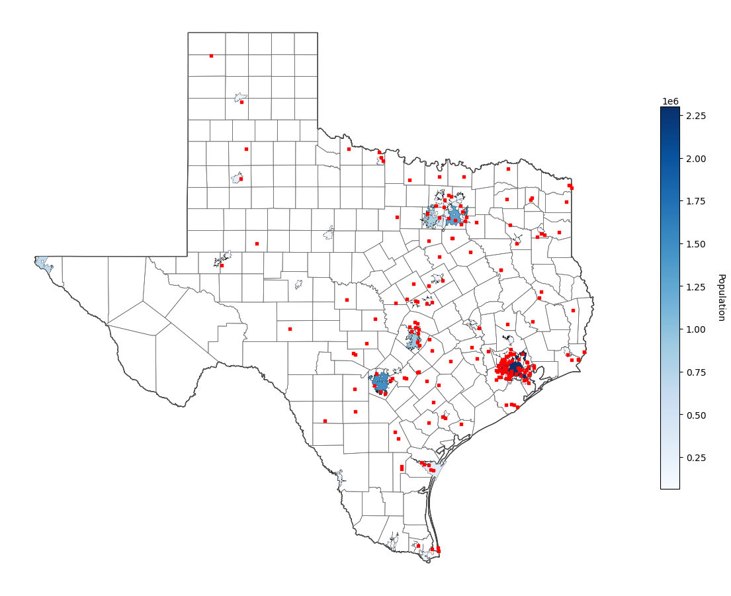
Population – TX
Population
Plotting Wastewater Treatment Plant Locations on Population Distribution Map
Source: Census Bureau, California Open Data Portal
Majority of WWTP are located in proximity to municipality.
Area with larger population tends to have more WWTPs.
Dallas, Houston, Austin, San Antonio
Some WWTPs are located in less densely populated areas, possibly serving smaller communities or industrial facilities

Slide 12
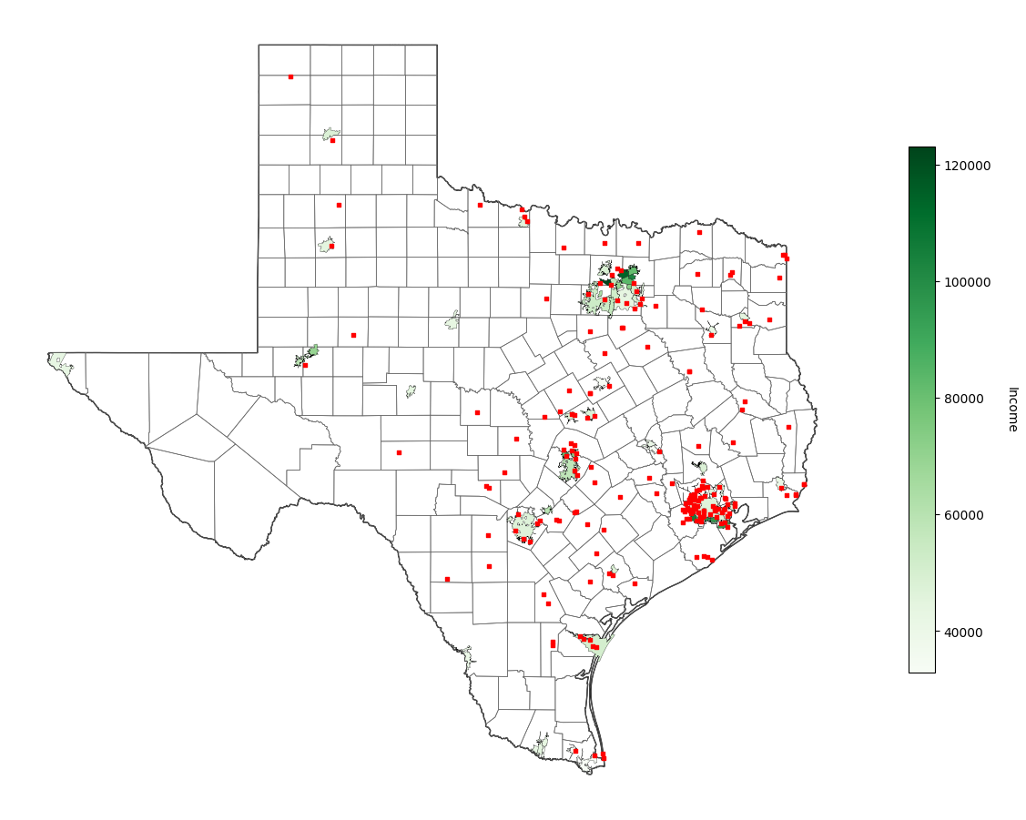
Income – TX
Income
Plotting Wastewater Treatment Plant Locations on Income Distribution Map
Income: Median Household Income in 2015
Source: Census Bureau, California Open Data Portal
No significant correlation was found

Slide 13
Response from Renan
Using CA.gov website, filtered based on:
Results in 2,017 locations → Additional filtering of Place/Project Type = Only Wastewater Treatment Facility
Results in 1,058 locations
But is this a true number?

Slide 14
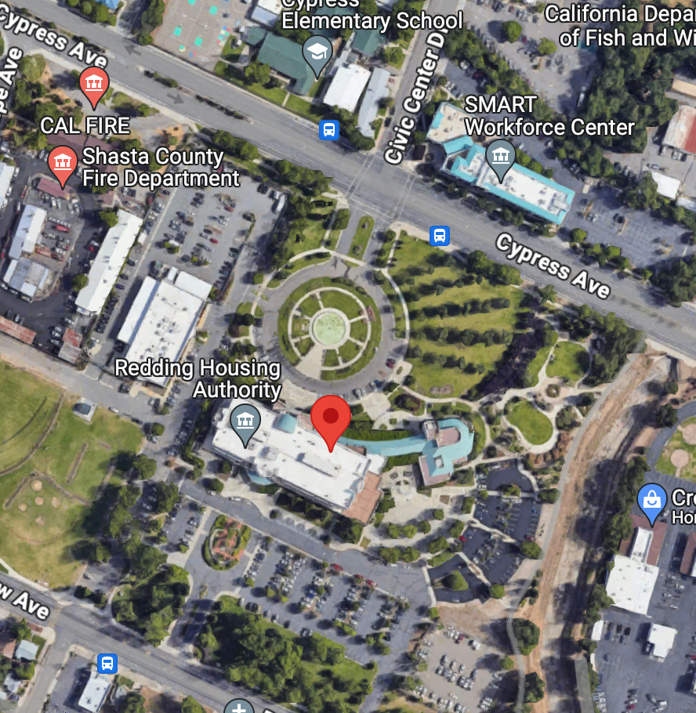
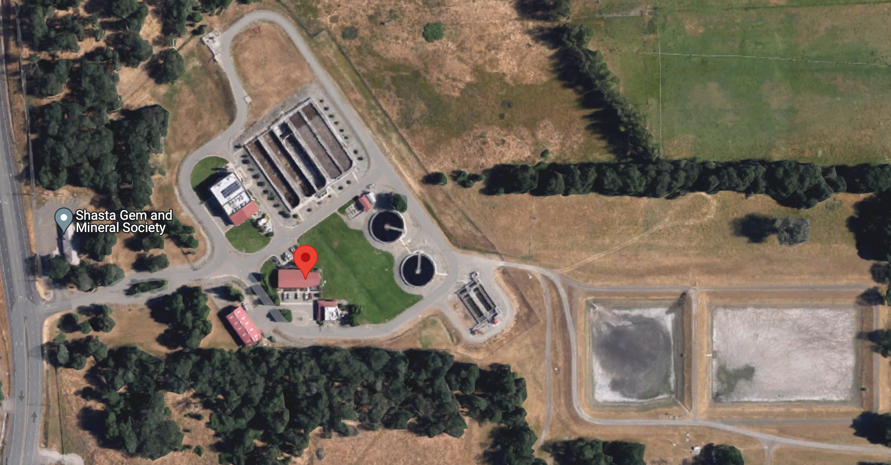
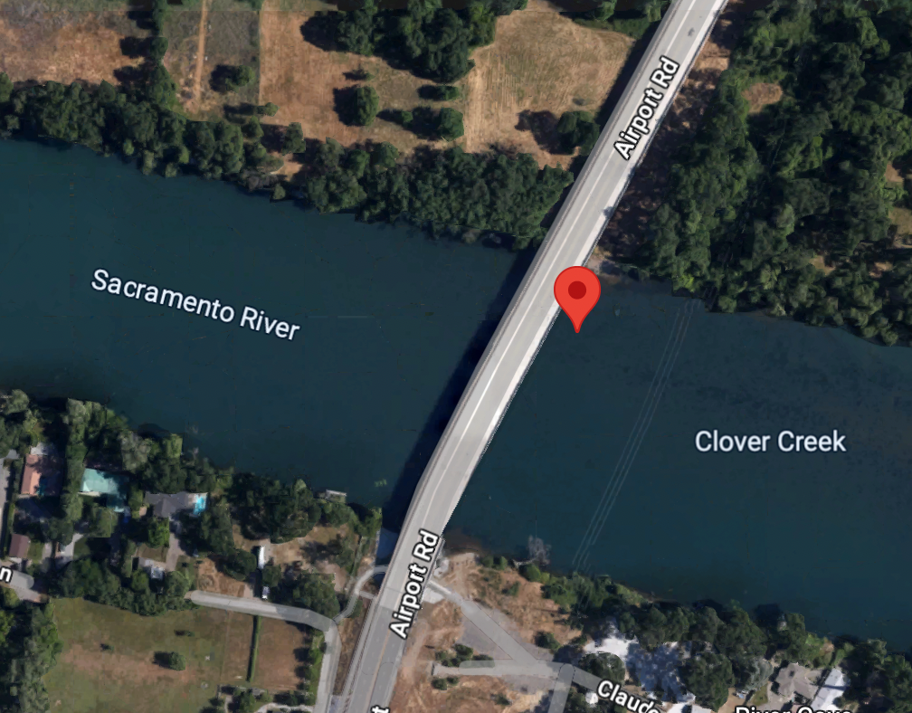
WWTP Examples from CA.gov (Correct Tagging)
1
Agency
Facility
Latitude, Longitude
777 Cypress Avenue, Redding, CA 96001-6071
6475 Airport Road, Anderson, CA 96007
40.4722, -122.294071
Sacramento River, CA

Slide 15
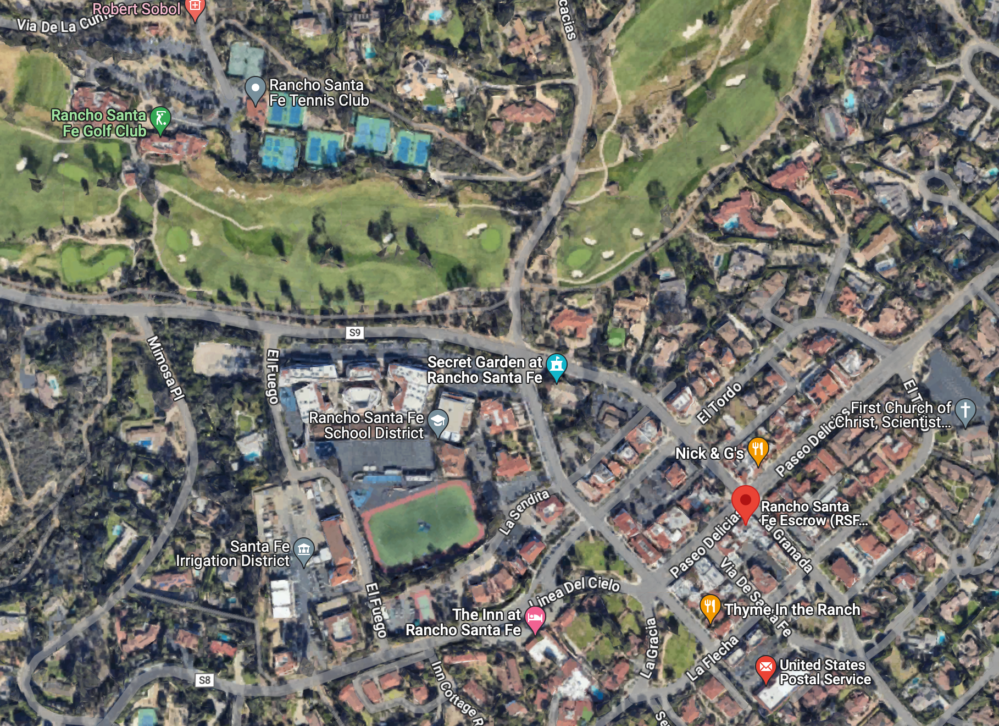
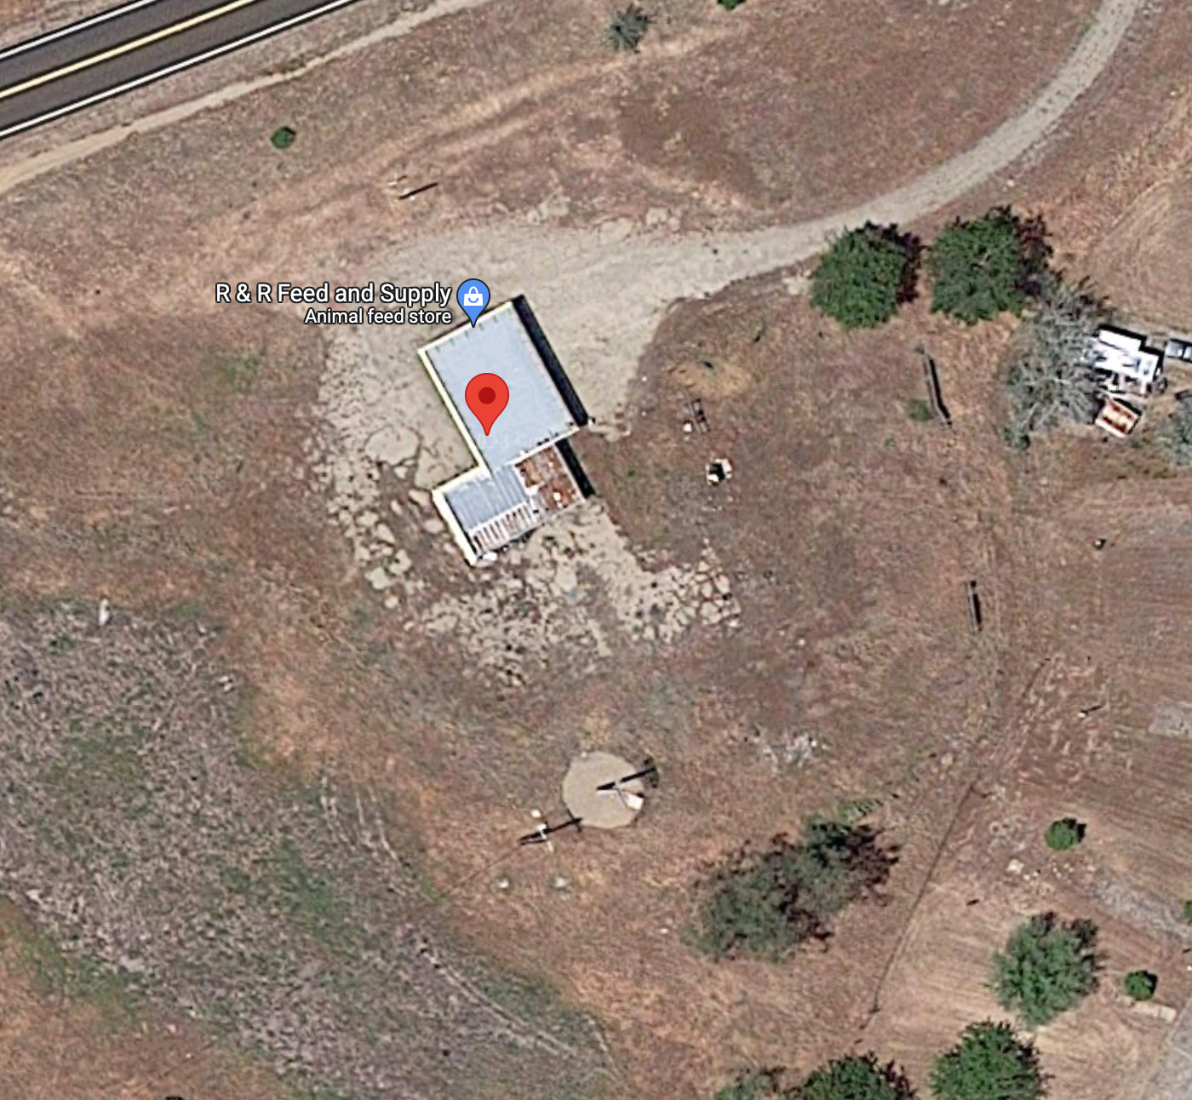
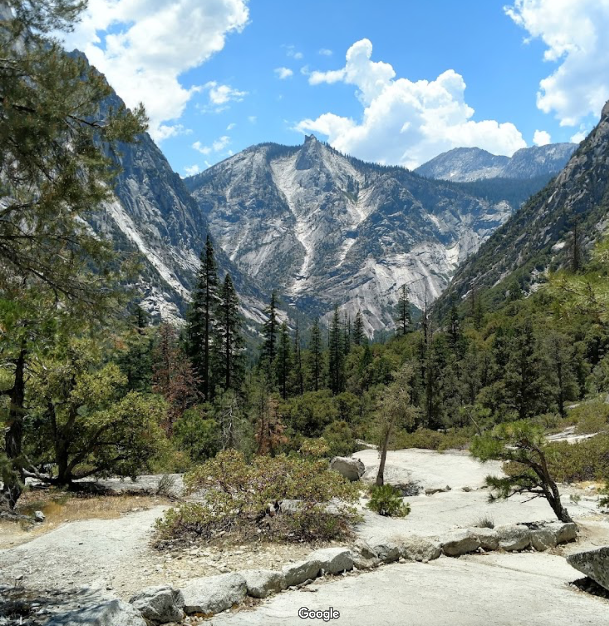
WWTP Examples from CA.gov (Incorrect Tagging)
2
Agency
Facility
Latitude, Longitude
P.O. Box 128, Rancho Santa Fe, CA 92067
35671 Kings Canyon Road, Dunlap, CA 93621
36.760916, -119.112263
Kings Canyon Joint Unified School District, CA

Slide 16
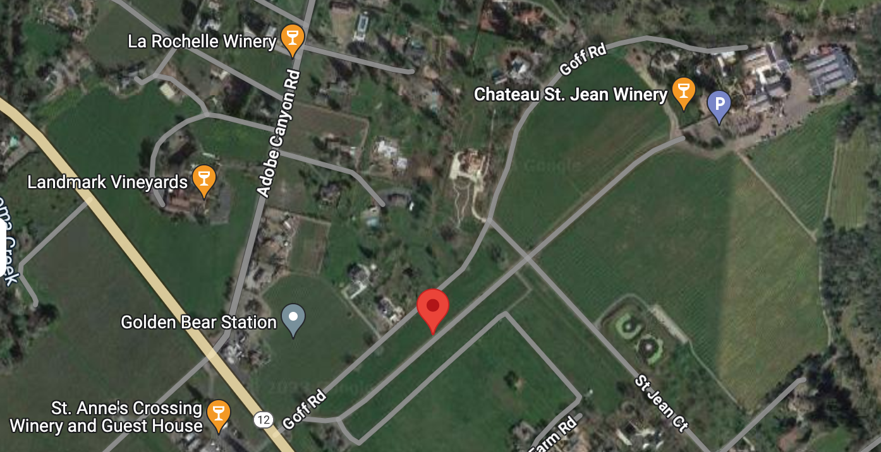
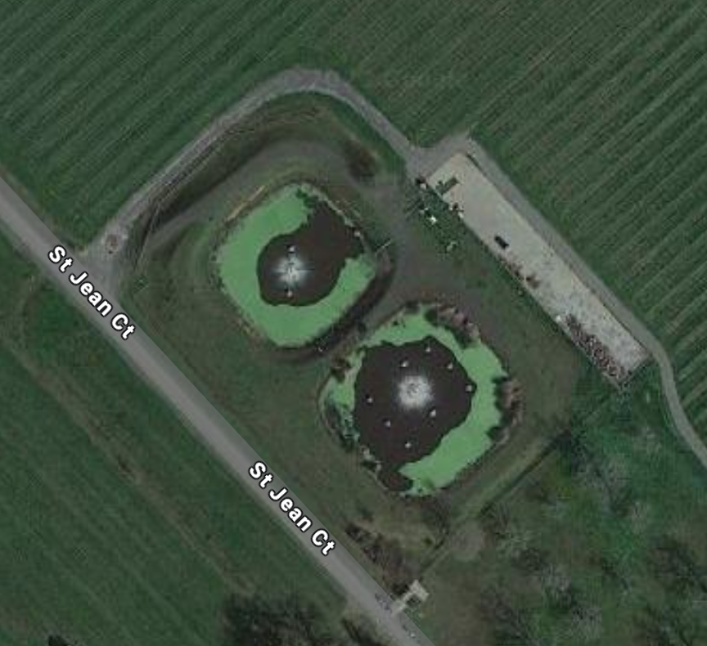
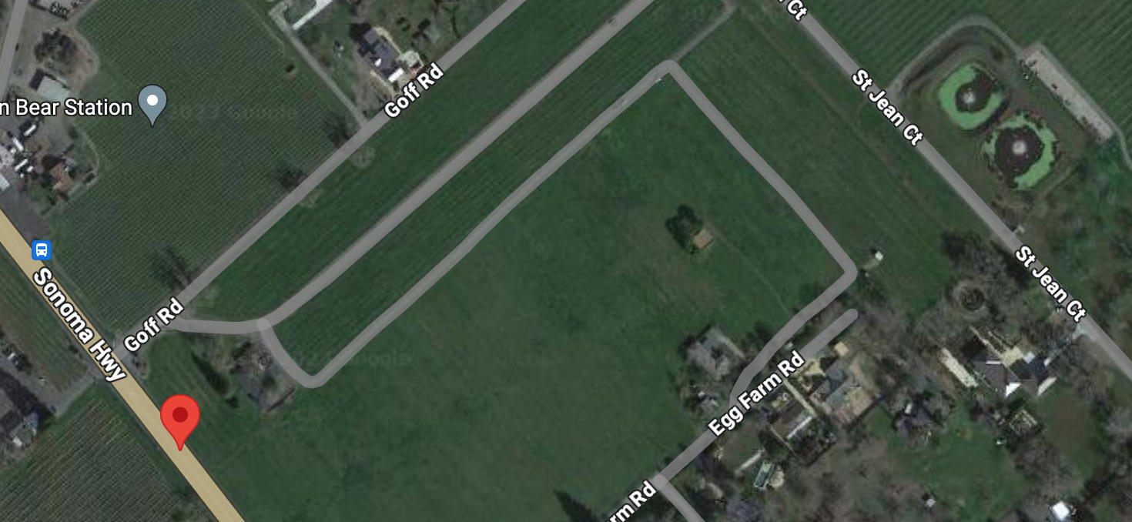
WWTP Examples from CA.gov (Wrong Tagging)
3
Agency
Facility
Latitude, Longitude
8555 Sonoma Highway, Kenwood, CA 95452
8555 Sonoma Highway, Kenwood, CA 95452
38.422783, -122.554662
Chateau St Jean Winery WW Ponds

Slide 17
Future Plan
Continue tagging the rest of the states from OSM to build up training data
Develop and fine-tune a segmentation model with the training data we obtained from OSM
Download images from EPA/gov as candidate model input
Segment candidate images using model

Slide 18
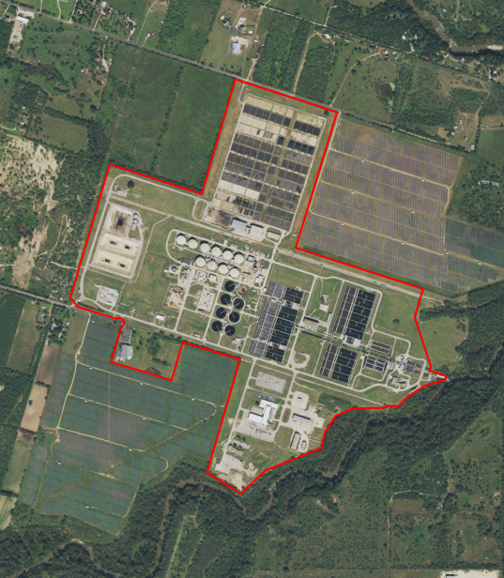
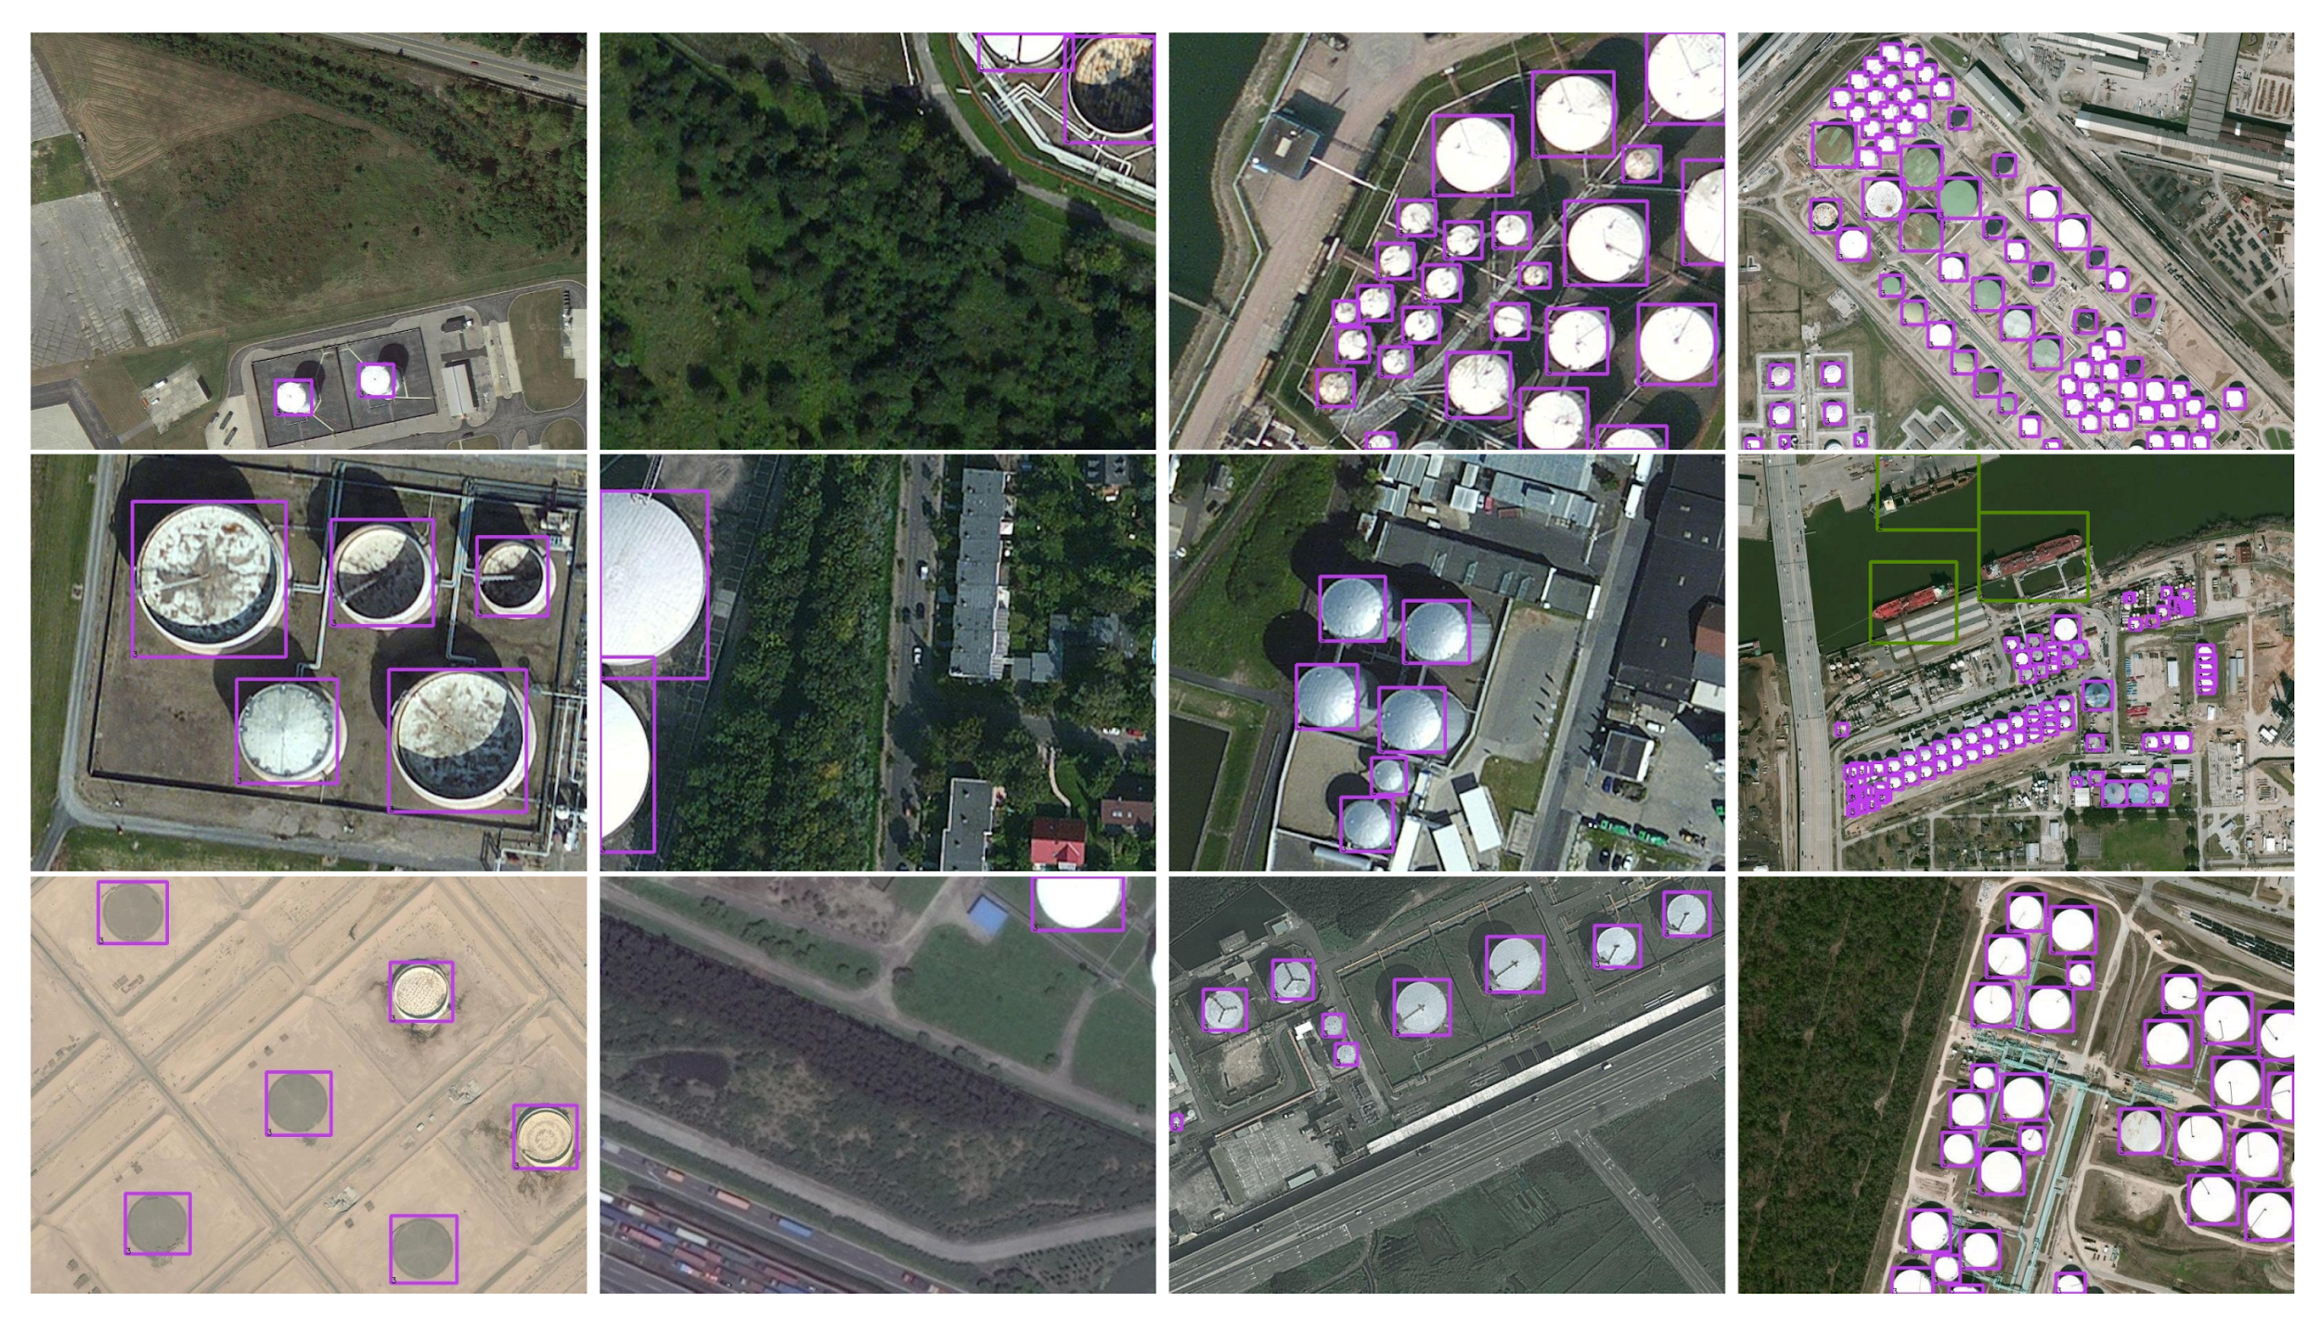
Future Plan (Continued)
Utilize computer vision algorithms
Image segmentation model
Object detection model
Tag more WWTPs nationally
Fine-tune models
Source: https://www.mdpi.com/2072-4292/13/5/862#

Slide 19
Questions for Christine
Could your team review our Maybe list for CA and TX to give us more insights when we tag other states?
Seeing that NPDES is a national requirement/regulation, can we assume all states have a control board similar to CA to augment our OSM/EPA datasets?

Slide 20
Appendix
Google drive folder of this project
Link for CA Gov
EPA Link

